Slide 1
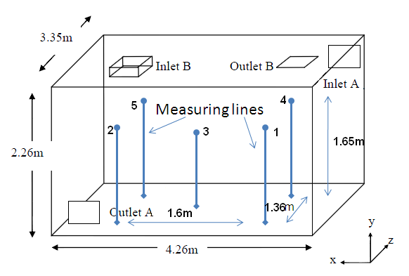
Inlet
0.48m
0.23m
0.72m
0.23m
1
0.48m
4
1
3
5
2
1.36m
2
0.38m
Outlet
0.8375m
3.75m
a) Isometric view
b) View from above

